Slide 1
Control

Slide 2
Control
Two of the most important parts of program execution
Data flow (Accessing and operating data)
Control flow (control the sequence of operations)

Slide 3
Control
Sequential execution(顺序代码执行) is default
the instructions are executed in the order they appear in the program
Change the control flow
Jump instructions

Slide 4
Jump Instructions
movq $0, %rax Set %rax to 0
jmp .L1 Goto .L1
movq (%rax), %rdx Null pointer dereference(skip)
.L1:(L代表一个label，其对应于一个具体的地址)
popq %rdx Jump target

Slide 5
Unconditional jump
Jumps unconditionally
Direct jump: jmp label
jmp .L(跳到label对应的地址(的语句))
Indirect jump:
jmp *Operand(memory/register)
jmp *%rax(跳到%rax存储的值对应的指令处)
jmp *(%rax)(跳到%rax存储的值对应的地址所存储的值对应的指令处)

Slide 6
Conditional jump(有条件的跳)
Either jump or continue executing at the next instruction in the code sequence
Depending on some combination of the condition codes
Such as jl, jge, jb, … etc.
All direct jump

Slide 7
PC-relative in the Relocatable Object
movq %rdi, %rax
2 jmp .L2
3 .L3:
sarq %rax
5 .L2:
testq %rax, %rax
7 jg .L3
rep; ret

Slide 8
Jump Targets in Binary
Two forms to represent a jump target
PC-relative
Jump target is an offset relative to the address of the instruction just followed jump (pointed by PC(指向当前执行指令的下一条的地址))
Absolute address
Jump target is an absolute address

Slide 9
PC-relative in the Relocatable Object
loop:
1 0: 48 89 f8 movq %rdi, %rax
2 3: eb 03 jmp 8<loop+0x8>
3 5: 48 di f8 sari %rax
4 8: 48 85 c0 testq %rax, %rax
5 b: 7f f8 jg 5<loop+0x5>
6 d: f3 c3 repz retq
03 + 5 = 8
f8( -8 ) + d = 5
此处的：前面的值都是相对地址(相对400 000 )
03 f8 被称为偏移值
小地址到大地址是个正数，反之是负数
1个byte

Slide 10
PC-relative in the Executable Object
loop:
1 4004d0: 48 89 f8 movq %rdi, %rax
2 4004d3: eb 03 jmp 8<loop+0x8>
3 4004d5: 48 di f8 sari %rax
4 4004d8: 48 85 c0 testq %rax, %rax
5 4004db: 7f f8 jq 5<loop+0x5>
6 4004dd: f3 c3 repz retq
03 + 4004d5 = 4004d8
f8( -8 ) + 4004dd = 4004d5

Slide 11
Translate Control Constructs in C

Slide 12
Control Constructs in C
Loop
while () { }
do { } while ()
for (init; test; incr) { }

Slide 13
Translating Conditional Branches
t = test-expr ;
if ( t ) goto true ;
else-statement
goto done
true:
then-statement
done:
if ( test-expr )
then-statement
else
else-statement

Slide 14
Translating Conditional Branches
long lt_cnt = 0 ;
long ge_cnt = 0 ;
long absdiff_se(long x, long y)
{
long result ;
if (x < y) {
lt_cnt++
return y – x;
}
else {
ge_cnt++ ;
return x – y;
}
}
long gotodiff_se(long x, long y)
{
long result ;
if (x >= y) goto x_ge_y ;
lt_cnt++ ;
result = y – x ;
return result ;
x_ge_y:
ge_cnt++ ;
result = x – y;
return result;
}

Slide 15
Jump Instructions
absdiff_se:
cmpq %rsi, %rdi Compare x : y
jge .L2 if x >= y goto x_ge_y
addq $1, lt_cnt lt_cnt++
movq %rsi, %rax Copy y:%rax用于保存返回值
subq %rdi, %rax result = y - x
ret Return
.L2 x_ge_y:
addq $1, ge_cnt ge_cnt++
movq %rdi, %rax Copy x
subq %rsi, %rax result = x - y
ret Return

Slide 16
Conditional Move
Original C code
long absdiff(long x, long y)
{
long result ;
if (x < y)
result = y-x ;
else
result = x-y ;
return result ;
}
(b) Implementation using conditional assignment
1 long cmovdiff(long x, long y) {
2 long rval = y-x;
3 long eval = x-y;
4 long ntest = x >= y;
5 /* Line below requires
6 single instruction: */
7 if (ntest) rval = eval;
8 return rval;
9 }

Slide 17
Conditional Move
(c) Generated assembly code
(x at %rdi, y at %rsi)
absdiff:
movq %rsi, %rax Copy y
subq %rdi, %rax rval = y-x
movq %rdi, %rdx Copy x
subq %rsi, %rdx eval = x-y
cmpq %rsi, %rdi Compare x:y
cmovge %rdx, %rax If >= , rval = eval
ret Return rval
%rax y-x
%rdx x-y

Slide 18
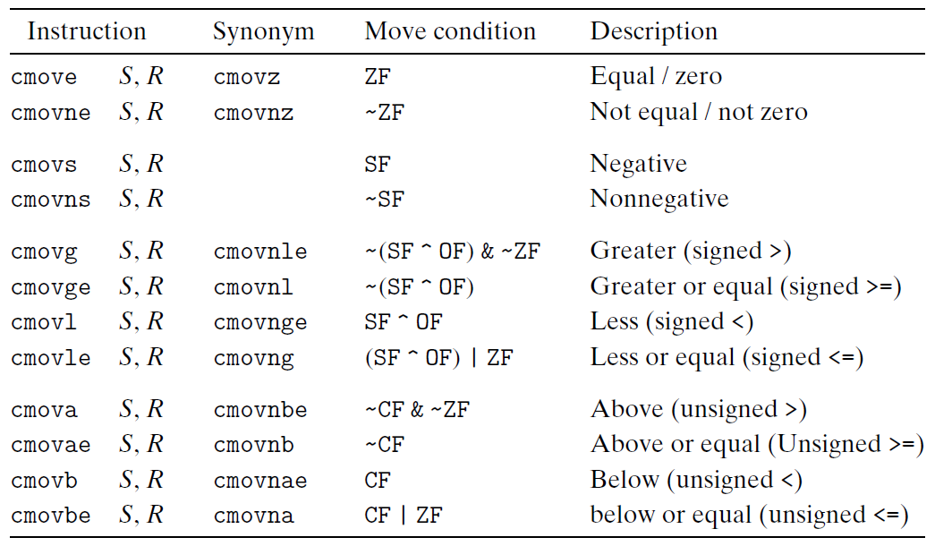
Conditional Move
Properties of Switch Construct
Integer testing
Multiple outcomes (may be a large number)
Improve the readability of the source code

Slide 19
Conditional Move
Source and destination values can be 16, 32, or 64 bits long
Source can be either a register or a memory location
Destination must be a register

Slide 20
Invalid Situation
Conditional Move instructions suppose that “there is no side effect”(没有副作用才可以cmov)
int cread(int *xp) {
return (xp ? *xp : 0); (直接cmov空指针的内容会报错)
}

Slide 21
Do-while Translation
do
body-statement
while (test-expr)
loop:
body-statement
t = test-expr;
if ( t )
goto loop ;

Slide 22
Do-while Translation
long fact_do(long n)
{
long result = 1;
do {
result *= n;
n = n-1;
} while ( n > 1) ;
return result;
}
long fact_do_goto(long n)
{
long result = 1;
loop:
result *= n;
n = n-1;
if ( n>1)
goto loop;
return result;
}

Slide 23
Do-while Translation
# n in %rdi
fact_do:
movl $1, %rax # result = 1
.L2: # loop:
imulq %rdi, %rax # result *= n
subq $1, %rdi # n = n-1
cmpq $1, %rdi # compare n:1
jg .L2 # if >, goto loop
rep; ret # return
long fact_do_goto(long n)
{
long result = 1;
loop:
result *= n;
n = n-1;
if ( n>1)
goto loop;
return result;
}
register | value | initially
%rdi | n | n
%rax | result | 1

Slide 24
While Loop Translation
do
body-statement
while (test-expr)
loop:
body-statement
t = test-expr;
if ( t )
goto loop ;
while (test-expr)
body-statement
goto test;
loop:
body-statement
test:
t = test-expr
if ( t )
goto loop;
但是直接goto的方式不利于程序的优化

Slide 25
While Translation
long fact_while(long n)
{
long result = 1;
while (n > 1) {
result *= n;
n = n-1;
}
return result;
}
long fact_while_jm_goto(long n)
{
long result = 1;
goto test;
loop:
result *= n;
n = n-1;
test:
if ( n > 1 )
goto loop;
return result;
}

Slide 26
While Translation
# n in %rdi
fact_while:
movl $1, %rax # result = 1
jmp .L5 # goto test
.L6: # loop:
imulq %rdi, %rax # result *= n
subq $1, %rdi # n = n-1
.L5: # test:
cmpq $1, %rdi # compare n:1
jg .L6 # if >, goto loop
rep; ret # return
long fact_while_jm_goto(long n)
{
long result = 1;
goto test;
loop:
result *= n;
n = n-1;
test:
if ( n > 1 )
goto loop;
return result;
}
register | value | initially
%rdi | n | n
%rax | result | 1

Slide 27
While Loop Translation
while (test-expr)
body-statement
goto test;
loop:
body-statement
test:
t = test-expr
if ( t )
goto loop;

Slide 28
While Translation
long fact_while(long n)
{
long result = 1;
while (n > 1) {
result *= n;
n = n-1;
}
return result;
}
long fact_while_gd_goto(long n)
{
long result = 1;
goto test ;
loop:
result *= n;
n = n-1;
test:
if ( n != 1 )
goto loop;
return result;
}

Slide 29
While Loop Translation (guarded do)
while (test-expr)
body-statement
与之前的直接goto相比下面的方法有利于优化
t = test-expr;
if ( !t )
goto done;
do
body-statement
while (test-expr);
done:
t = test-expr
if ( !t )
goto done;
loop:
body-statement
t = test-expr
if ( t )
goto loop;
done:

Slide 30
While Translation
long fact_while(long n)
{
long result = 1;
while (n > 1) {
result *= n;
n = n-1;
}
return result;
}
long fact_while_gd_goto(long n)
{
long result = 1;
if ( n <= 1 )
goto done;
loop:
result *= n;
n = n-1;
if ( n != 1 )
goto loop;
done:
return result;
}

Slide 31
While Translation
# n in %rdi
fact_while:
cmpq $1, %rdi # compare n:1
jle .L7 # if <=, goto done
movl $1, %rax # result = 1
.L6: # loop:
imulq %rdi, %rax # result *= n
subq $1, %rdi # n = n-1
cmpq $1, %rdi # compare n:1
jne .L6 # if !=, goto loop
rep; ret # return
.L7 # done:
movl $1, %eax # result = 1
ret # return
long fact_while_gd_goto(long n)
{
long result = 1;
if ( n <= 1 )
goto done;
loop:
result *= n;
n = n-1;
if ( n != 1 )
goto loop;
done:
return result;
}

Slide 32
For Loop Translation
for ( init-expr; test-expr; update-expr)
body-statement
init-expr
while ( test-expr) {
body-statement
update-expr
}
for→while→do .... while ...

Slide 33
Switch Construct
Properties of Switch Construct
Integer testing
Multiple outcomes (may be a large number)
Improve the readability of the source code

Slide 34
Switch Statements
void switch_eg (long x, long n, long *dest)
{
long val = x ;
switch ( n ) {(n必须是整数)
case 100:
val *= 13 ;
break ;
case 102:
val += 10 ;
/* fall through */
case 103:
val += 11 ;
break ;
case 104: case 106:
val *= val ;
break ;
default:
val = 0 ;
}
*dest = val ;
}
Multiple cases
Integer testing

Slide 35
Switch Form
switch(op) {
case val_0:
Block 0
case val_1:
Block 1
• • •
case val_n-1:
Block n–1
}

Slide 36
Jump Table
Efficient implementation
Avoid long sequence of if-else statement
Criteria
the number of cases and the sparcity of the case value

Slide 37
From Cases to Targets
switch(op) {
case val_0:
Block 0
case val_1:
Block 1
• • •
case val_n-1:
Block n–1
}
Targ0:
Code Block 0
Targ1:
Code Block 1
Targ2:
Code Block 2
•
•
•
Targn-1:
Code Block n–1

Slide 38
Construct a Jump Table
Jump Table(存在data area)
Jump Targets
jtab:
Targ0
val_0
Targ0:
Code Block 0
.
.
Targ1
val_1
Targ1:
Code Block 1
.
.
Targ2
val_2
Targ2:
Code Block 2
•
•
•
•
•
•
Targn-1
val_n-1
Targn-1:
Code Block n–1
entry

Slide 39
Implement the Switch
Approx. Translation
Jump Targets
target = JTab[op];
goto *target;
Targ0:
Code Block 0
Jump Table
Targ1:
Code Block 1
jtab:
Targ0
val_0
Targ2:
Code Block 2
………
Targ1
val_1
………
•
•
•
Targ2
val_2
•
•
•
Targn-1:
Code Block n–1
Targn-1
val_n-1

Slide 40
Switch Statements
void switch_eg (long x, long n, long *dest)
{
long val = x ;
switch ( n ) {
case 100:
val *= 13 ;
break ;
case 102:
result += 10 ;
/* fall through */
case 103
val += 11 ;
break ;
case 104: case 106:
val *= val ;
break ;
default:
val = 0 ;
}
*dest = val ;
}

Slide 41
Jump Table Implementation
Pointer to a code
location in GCC
int switch_eg_impl (long x, long n, long *dest)
{
static void *jt[7] = { &&loc_A, &&loc_def, &&loc_B, &&loc_C, &&loc_D, &&loc_def, &&loc_D
};
unsigned long index = n - 100;
long val ;
if ( index > 6 )
goto loc_def ; //default
goto *jt[index]; // multiway
loc_A: // case 100
val = x * 13 ;
goto done ;
loc_B: // case 102
x = x + 10 ; // fall through
loc_C: // case 103
val = x + 11;
goto done ;
loc_D: // case 104, 106
val *= x * x ;
goto done ;
loc_def: //default
val = 0 ;
done:
*dest = val ;
}

Slide 42
Code Layout
Linux X86-64 process
memory image
Stack
Heap
DLLs
Heap
rwdata
rodata
00400000
Text
%eip
00000000

Slide 43
Jump Table
.section .rodata
.align 8 align address to multiple of 8
.L4:
.quad .L3 case 100: loc_A
.quad .L8 case 101: loc_def
.quad .L5 case 102: loc_B
.quad .L6 case 103: loc_C
.quad .L7 case 104: loc_D
.quad .L8 case 105: loc_def
.quad .L7 case 106: loc_D

Slide 44
Jump Table Implementation
x in %rdi, n in %rsi, dest in %rdx
switch_eq
subq $100, %rsi compute index = n – 100
cmpl $6, %rsi compare index:6
ja .L8 if > , goto loc_def
jmp *.L4 (, %rsi, 8) //跳到jumptable(data area)
.L3: loc_A:
leaq (%rdi, %rdi, 2), %rax 3*x
leaq (%rdi, %rax, 4) ,%rdi val = 13*x
jmp .L2 goto done

Slide 45
Jump Table Implementation
.L5: loc_B:
addq $10, %rdi x = x + 10
.L6: loc_C:
addq $11, %rdi val = x + 11
jmp .L2 goto done
.L7: loc_D:
imulq %rdi, %rdi val = x * x
jmp .L2 goto done
.L8: loc_def:
movl $0, %edi val = 0

Slide 46
Jump Table Implementation
.L2 done:
movq %rdi, (%rdx) *dest = val
ret return

